Slide 1
PracExtractor: Extracting Configuration Good Practices from Manuals to Detect Server Misconfigurations
Chengcheng Xiang¹, Haochen Huang¹, Andrew Yoo¹, Yuanyuan Zhou¹, Shankar Pasupathy²
1
2
Notes:
Hello everyone, I'm Chengcheng, today I'm glad to present our work on PracExtractor, Extracting Configuration Good Practices from Manuals to Detect Server Misconfigurations.
This is a joint work beteen UC San Diego and NetApp.

Slide 2
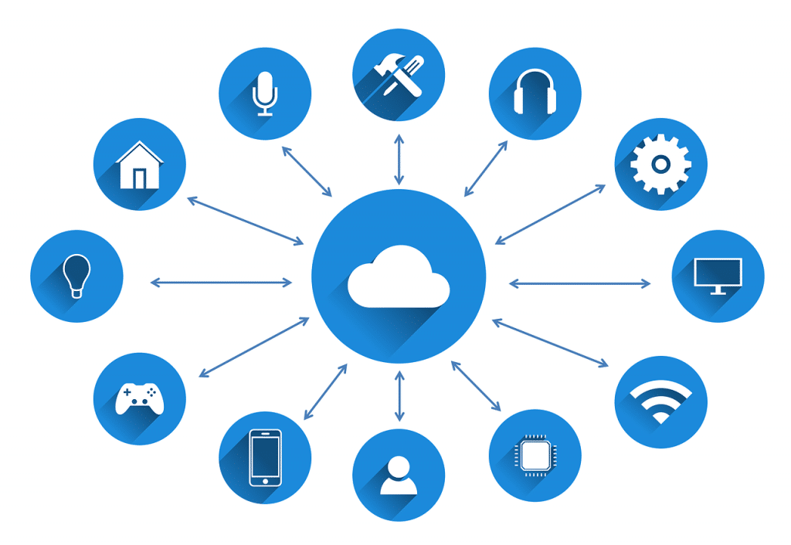
Our lives are largely served by online services today
Notes:
Our lives are largely supported by online services today. Especially under this quarantine, almost everything we are doing is through online services.
Whether it is something we want to do, like online shopping or gaming, or something we don’t want to do, like working from home or attending online meeting such as this one, it all needs to go online.

Slide 3
What serve us are these powerful and complex data center systems
Notes:
Behind the services, what serve us are these powerful and complex data center systems.
Many different programs is running on hundreds of thousands of machines to handle our requests.

Slide 4
In particular: data center configuration has become highly complex
No. of parameters
Too many config parameters
1376
Parameters are correlated
940
669
426
Notes:
One thing, in particular, has become highly complex is the configuration of data center systems.
Let’s take a look at the common software that runs in datacenter, like Hadoop, mysql, apache, etc.
They all have hundreds to thousands of parameters need to be configured.
And what makes things worse is many of these parameters are correlated.

Slide 5
Software release large manuals to assist sysadmins with configurations
5494 pages
3724pages
Too long to read
2331
pages
Not easy to navigate
Sysadmin
Unreliable sources
1009pages
787
pages
Notes:
To tackle configuration complexity,
currently most software release large manuals to assist sysadmins with configurations.
But these manuals can have hundreds to thousands of pages.
With so many pages, manuals are too long for humans to read.
And also, manuals are also hard to navigate. They are usually organized by parameters. If you don’t know which parameter to change, it’s hard to find related content.
As a result, sysadims usually turn to online forums like stack overflow to resolve their issues.
Online forums may provide unreliable answer which may be partially correct or correct in certain condition.

Slide 6
Is there any useful information that can be automatically extract from manuals?
Yes! Good Practices
Describe how to set parameters in a good way from usage experiences
Examples
Software | parameter | Good practices | Violation outcomes
Httpd | ExtendedStatus | For highest performance, set ExtendedStatus off. | Performance downgrade
HBase | hbase.regionserver.thrift.framed | Setting this to false will select the default transport, vulnerable to DoS. | Vulnerable to DoS attack
Cassandra | enable_transient_replication | Transient replication is experimental and is not recommended for production use. | Unreliable service
Notes:
Based on this, this work try to study software manuals to see if there is any useful information that can be automatically extract from manuals so that we can build automatic tools to help sysadmins check their configurations.
Yes, we found something promising called good practices that can be helpful.
Good practices describe how to set parameters in a good way from usage experiences.
Here are some example of good practices from different software manuals and for various parameters.
For example, the second row describes that in Httpd, it is recommended to set ExtendedStatus off for highest performance.
Breaking these good practices can cause various outcomes, including performance downgrade, security vulnerability and reliability issue.

Slide 7
How useful are the good practices in manuals?
Q1: Are good practices specific or general?
General good practices like “set to a large value” are not helpful.
We collected 261 good practices from six software manuals to answer these questions
Q2: Are good practices already checked in source code?
If they are, it is non-necessary to extract them from manuals.
Q3: Are good practices always equivalent to default settings?
If they are, then sysadmins can just leave configurations as default.
Notes:
To further validate if it is worthwhile to extract the good practices in manuals to build checkers, we further studied three questions:
First, Are good practices specific or general?
If good practices are general like “set to a large value”, they are not helpful.
Second, Are good practices already checked in source code?
If they are, that means the software will probaby give warning when sysadmins’ configuration violates these good practices.
It is non-necessary to extract the good practices from manuals to build another checker.
Third, Are good practices always equivalent to default settings?If they are, then sysadmins can just leave configurations as default
We collected 261 good practices from six software manuals and studied them to answer these questions.

Slide 8
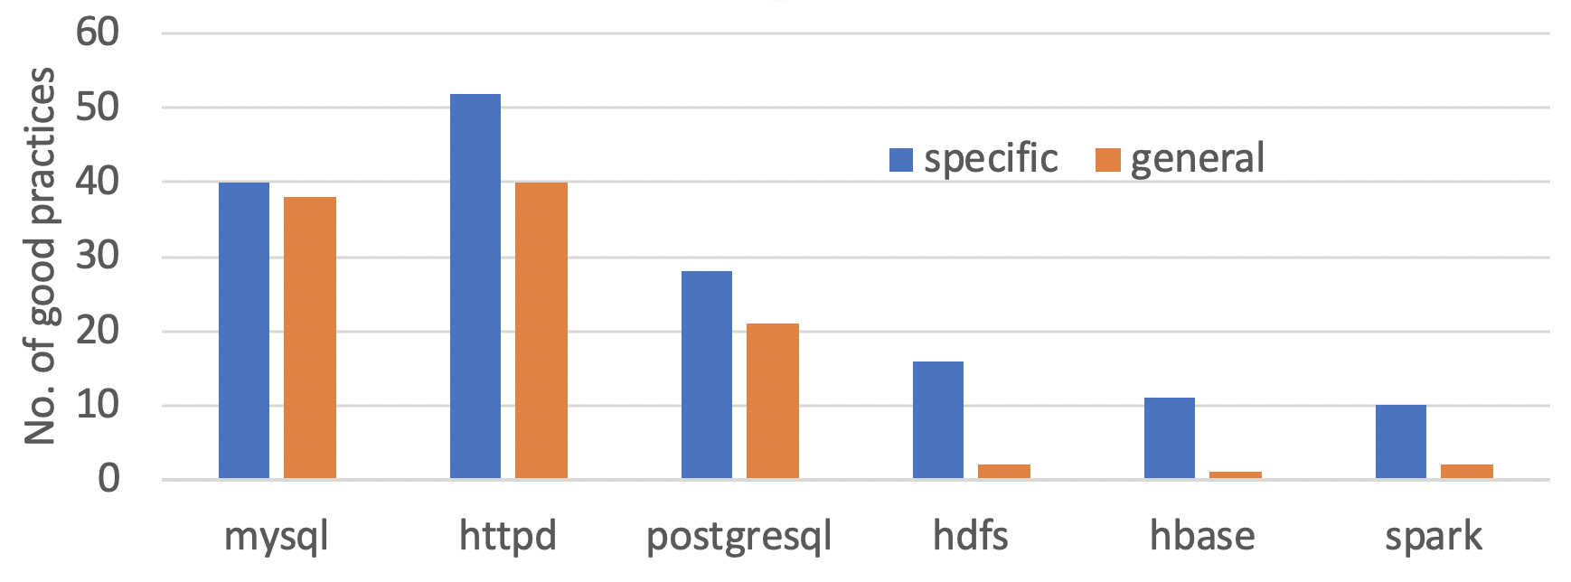
How useful are the good practices in manuals?
Q1: Are good practices specific or general?
General advice like “set to a large value” is not helpful.
Answer: 60% of studied good practices are specific.
Notes:
For the first question, the answer is 60% of them are specific.
This bar chart shows the number of specific and general good practices described in different software manuals.
As most of them are specific, they can be used for automatic checking.

Slide 9
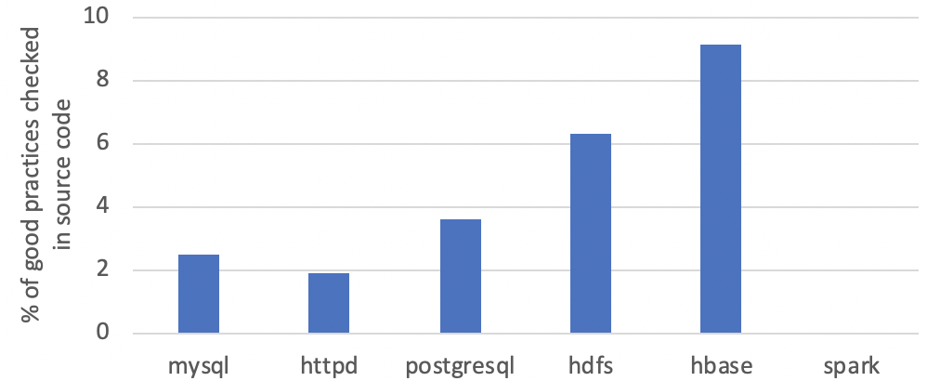
How useful are the good practices in manuals?
Q2: Are good practices already checked in source code?
If they are, it is non-necessary to extract them from manuals.
Answer: only 3% of specific good practices are checked in source code.
Notes:
For the second question, only 3% of specific good practices are checked in source code.
This bar chart shows the percentage of these good practices.
It indicates these program themselves will not generate warnings if most good practices are violated.
Therefore, it requires additional checking to warn these violations.

Slide 10
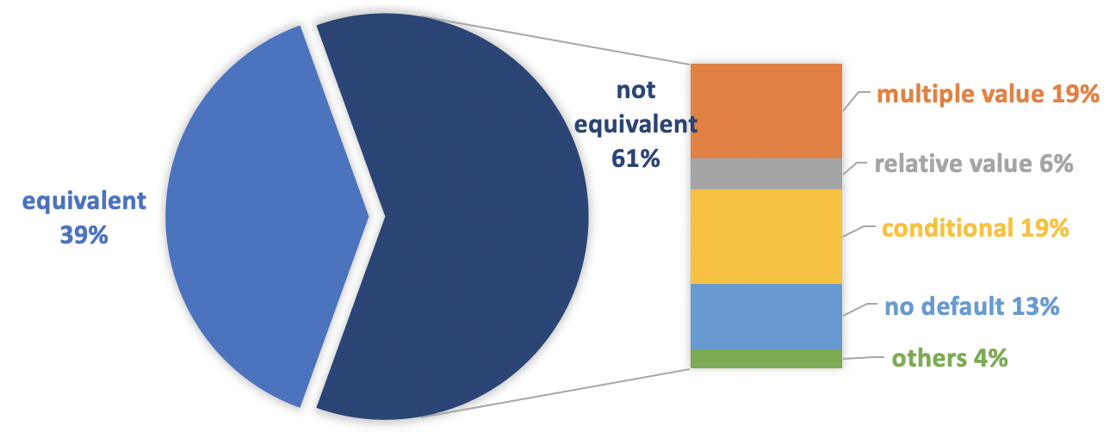
How useful are the good practices in manuals?
Q3: Are good practices always equivalent to default settings?
If they are, then sysadmins can just leave configurations as default.
Answer: 61% of specific good practices are not equivalent to default settings
Notes:
For the third question, 61% of specific good practices are not equivalent to default settings
This pie chart shows the percentage and the stacked bar further decomposes the reason why good practices are not equivalent to default settings
The most common reasons are multiple values and conditional good practices.
multiple values means A good practice may recommend multiple values to have sysadmins choose the one suit their environment most
Conditional good practices are those recommend values based on some condition, for example, if parameter a is enabled, it recommends to enable b
13% of them are because some non-optional parameters have no default
6% of them are because some good practice recommend relative value, like 20% of the memory size
The remaining 4% are those we don’t find a reason that they can be different.
We reported them to developers and 1 of them are confirmed as bugs in the default value.

Slide 11
Based on the study we designed PracExtractor to
Extract
Good practices descriptions
p1: “The crc32 option is recommended."
p2: “A value between 8 to 16 is suggested.”
p3: “We suggest to set it less than ThreadsPerChild.”
Convert
Check
Specifications
p1 == crc32
p2 $∈$ [8, 16]
p3 < ThreadsPerChild
Manual
Config files
p2 = 6
…
Notes:
Based on the study we designed PracExtractor to
First extract good practices descriptions from manuals. For example, the second sentence describes for parameter p2, “A value between 8 to 16 is suggested.” ”
then PracExtractor converts these text descptions into checkable specifications. P2’s good practice has been converted into a range.
With the converted specifications, PracExtractor checks sysadmins’ configs to see if there is any violations. In this case, p2’s value violate its good practice and so a warning is generated for sysadmins to double-check

Slide 12
Two challenges with PracExtractor
How to effective filter noises and extracts only good practice descriptions?
99.6% – 97.3% of sentences in manuals are NOT related to good practices.
How to convert good practice descriptions in free-text into checkable specifications?
Sentences like “the crc32 option is recommended” is not directly checkable
Notes:
PracExtractor faces two challenges
First, as manuals are written in plain texts and have a large amount of texts unrelated to good practices, how to effectively filter noises and extract only good practices?
Second, even after PracExtractor extract good practice descriptions. They are all in free-text. How to convert them into formal specifications that can be used for automatically checking?

Slide 13
Challenge 1: Extract good practice descriptions
Keyword filtering
Syntactic-pattern filtering
Notes:
For the first challenge, pracextractor adopts both keyword filtering and syntactic-pattern filtering to extract good practice descriptions

Slide 14
Challenge 1: Extract good practice descriptions
Keyword filtering
Syntactic-pattern filtering
Sentences in manuals
“The crc32 option is recommended."
“This is not guaranteed even with the recommended settings”
“Specifies how to generate and verify the checksum stored in the disk blocks”
Keyword filtering
Good practices candidates
“The crc32 option is recommended."
“This is not guaranteed even with the recommended settings”
Notes:
Pracextractor first extracts sentencs that contain practices-related keywords as good practices candidates
In this example, the first and second sentences contains keyword "recommend" and so are extracted
The third sentence contains no keywords and so is filtered out.

Slide 15
Challenge 1: Extract good practice descriptions
Keyword filtering
Syntactic-pattern filtering
Good practices candidates
“The crc32 option is recommended."
“This is not guaranteed even with the recommended settings”
Notes:
PracExtractor then adopts syntactic-pattern filtering to further filter out the non-good practices from the candidates.
In this example, although the second sentences contains keyword recommend it recommends nothing and so is not a good practice
PracExtractor performs syntactic dependency analysis for each sentence.
We observed that good practices and non-good practices typically have different syntactic patterns.
For example, the first sentence and the second sentence have different syntatic patterns.
PracExtractor then uses the good practice-syntactic patterns to identify real good practices.
In this case, it is the crc32 option is reommended.
Csubj: clausal subject
Acomp: adjectival complement

Slide 16
Challenge 1: Extract good practice descriptions
Keyword filtering
Syntactic-pattern filtering
Good practices candidates
Syntactic-pattern filtering
csubj
acomp
Good practices descriptions
“The crc32 option is recommended."
The crc32 option is recommended .
nsubj
amod
This is not guaranteed even with the recommended settings.
Notes:
PracExtractor then adopts syntactic-pattern filtering to further filter out the non-good practices from the candidates.
In this example, although the second sentences contains keyword recommend it recommends nothing and so is not a good practice
PracExtractor performs syntactic dependency analysis for each sentence.
We observed that good practices and non-good practices typically have different syntactic patterns.
For example, the first sentence and the second sentence have different syntatic patterns.
PracExtractor then uses the good practice-syntactic patterns to identify real good practices.
In this case, it is the crc32 option is reommended.
Csubj: clausal subject
Acomp: adjectival complement

Slide 17
Challenge 2: Convert descriptions into specifications
Setting entity identification
Semantic pattern matching
Notes:
For the second challenge, PracExtractor also takes two steps to tackle it:
Setting entity identification and semantic pattern matching

Slide 18
Challenge 2: Convert descriptions into specifications
Setting entity identification
Semantic pattern matching
Good practices descriptions
p1: “The crc32 option is recommended.”
p2: “A value between 8 to 16 is suggested.”
p3: “We suggest to set it less than ThreadsPerChild.”
Good practices descriptions
p1: “The crc32 option is recommended.”
p2: “A value between 8 to 16 is suggested.”
p3: “We suggest to set it less than ThreadsPerChild .”
enum
int
int
parameter
Notes:
For Setting entity identification, PracExtractor identify entities such as enums, integers, and parameter names.
In this example, crc32 is identified as enum, 8 and 16 are identified as int and ThreadsPerChild is identified as a parameter.

Slide 19
Challenge 2: Convert descriptions into specifications
Setting entity identification
Semantic pattern matching
Good practices descriptions
p1: “The crc32 option is recommended.”
p2: “A value between 8 to 16 is suggested.”
p3: “We suggest to set it less than ThreadsPerChild .”
1. <enum>
2. between <int> to <int>
3. less than <parameter>
Specifications
p1 == crc32
p2 $∈$ [8, 16]
p3 < ThreadsPerChild
enum
int
int
parameter
Notes:
Then PracExtractor uses entity-based semantic patterns to match with each tagged sentence
For each pattern, PracExtractor generate specifications correspondingly.
Here the semantic patterns along with previous syntactic patterns and keywords are mined from the six software manuals in our characteristic study.
We will show their generality by using them to extract good practice specifications from six new software manuals.

Slide 20
Evaluation of PracExtractor
Extract good practices from software manuals
Detect real-world configuration errors
Notes:
We evaluate PracExtractor with two set of experiments.
First, we use PracExtractor to exatract good practices from software manuals to evaluate the extraction accuracy
Second, we use the extracted good practice specifications to detect real-world configurations errors.

Slide 21
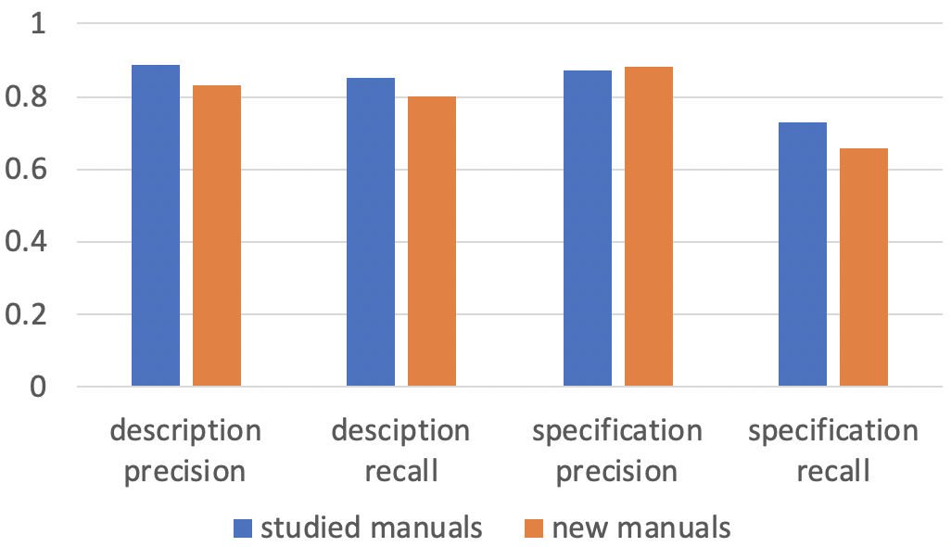
Evaluation of PracExtractor
Accuracy of good practice extraction
Training sets: 6 studied manuals included in our characteristic study
Testing sets: 6 new manuals not included in our study
Notes:
For the accuracy of good practice extraction,
we use 6 studied manuals included in our characteristic study as the training set
We use 6 new manuals not included in our study as the testing set
Here are the results, the training accuracy is in blue and the testing accuracy is in orange

Slide 22
Evaluation of PracExtractor
Accuracy of good practice extraction
Precision: what percentage of good practices extracted are true
Recall: what percentage of true good practices are extracted
Notes:
We use two metrics to measure the accuracy
Precision means what percentage of good practices extracted are true good practices
Recall means what percentage of true good practices are extracted

Slide 23
Evaluation of PracExtractor
Accuracy of good practice extraction
Good practice descriptions extraction
Notes:
The left four column shows the precision and recall of extracting good practice descriptions
We can see both for the studied and new manuals the precision and recall can reach over 80%.
The new manuals’ precision and recall are only slightly lower than studied one

Slide 24
Evaluation of PracExtractor
Accuracy of good practice extraction
Good practice specifications extraction
Notes:
The right four columns show the precision and recall for specification extraction.
The precision for the new manuals is close to the studied manuals.
The recall for the new manuals is lower than the studied manuals.
This is because some semantic patterns only exist in the new manuals but not the old manuals.
It can be further improved by increasing the traning set.

Slide 25
Evaluation of PracExtractor
Detect real-world configuration errors
Downloaded 2200 docker images from docker hub.
Detected 1423 practice violations from 853 unique images.
Got 47 confirmed as real configuration errors (325 reported in total).
Notes:
To evaluate PracExtractor’s capability on deteciting real-world configuration errors, we downloaded 2200 docker images from docker hub for PracExtractor to check.
PracExtractor detected 1423 practice violations from 853 unique images.
We reported 325 violations in repos that are maintained on github and got 47 of them confirmed as real configuration errors.

Slide 26
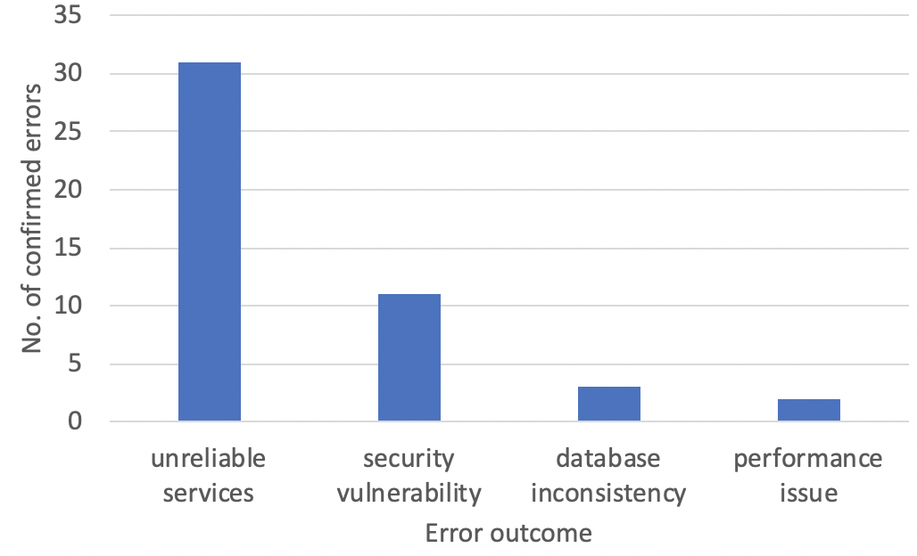
Evaluation of PracExtractor
Outcome of the confirmed configuration errors
Notes:
We further analyzed the outcome of the confirmed configuration errors.
31 of them will cause unreliable services, which leads to occasional failures.
11 lead to security holes that makes servers vulnerable to attacks,
3 cause database inconsistency and 2 cause performance issues.
This indicates the good practice violations indeed can cause severe outcomes

Slide 27
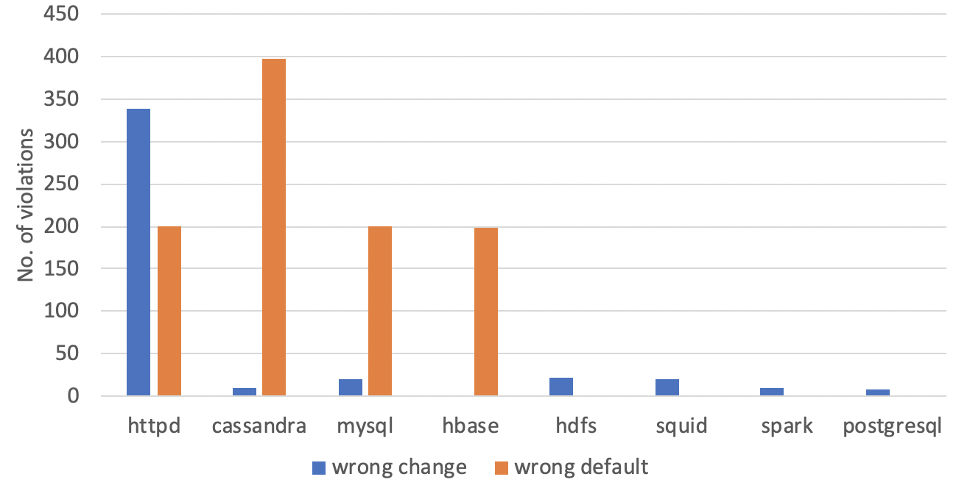
Evaluation of PracExtractor
Analysis of the detected violations
Wrong change: a parameter is changed to a value violating good practices
Wrong default: a parameter’s default violate good practices but is not changed
Notes:
We also analyzed the characteristic of the detected violations.
We divided them into wrong change and wrong default.
Wrong change means a parameter's setting is changed to a value violating good practices proactively by sysadmins
Wrong default means a parameter’s default setting violate good practices but is not changed
Here come the results.

Slide 28
Evaluation of PracExtractor
Analysis of the detected violations
Wrong change: a parameter is changed to a value violating good practices
Wrong default: a parameter’s default violate good practices but is not changed
Notes:
The most common violations are wrong defaults, this implies that sysadmins tends to leave default settings as they are.
Our PracExtractor can help sysadmins check these wrong defaults and warn them about the violations.

Slide 29
Evaluation of PracExtractor
Analysis of the detected violations
Wrong change: a parameter is changed to a value violating good practices
Wrong default: a parameter’s default violate good practices but is not changed
Notes:
Another interesting observation is that httpd has many cases of wrong change.
We looked into this and found this is because httpd has many non-optional parameters that has no default.
Sysadmins have to set these values for themselves. This indicates sysadmins indeed fail to follow good practice in manuals when making their own settings.
Our pracExtrators can help sysadmins detect these violations and provides the good practices for them to correct the violations.

Slide 30
Summary of PracExtractor
Identified good practices as useful information from manuals for configuration validation.
Studied 261 good practices from six software manuals to prove usefulness.
Built PracExtractor to automatically extract good practices from manuals.
PracExtractor achieved reasonably high precision and recall.
PracExtractor detected 47 real-world configuration errors.
Notes:
To summarize our study
We first identified good practices as useful information from manuals for detecting configuration errors
We studied 261 good practices from six software manuals to prove usefulness the good practices.
Then we built PracExtractor to automatically extract good practices from manuals.
PracExtractor achieved reasonably high precision and recall.
PracExtractor detected 47 real-world configuration errors.

Slide 31
Thank you!
c4xiang@cs.ucsd.edu
Notes:
With this, I would like to conclude my talk.
Thank you for listening to my talk. Please feel free to email me if you have any questions.

