Slide 1
Towards Continuous Access Control Validation and Forensics
CCS 2019
Chengcheng Xiang¹, Yudong Wu¹, Bingyu Shen¹, Mingyao Shen¹, Haochen Huang¹,
Tianyin Xu², Yuanyuan Zhou¹, Cindy Moore¹, Xinxin Jin³, Tianwei Sheng³
1
2
3
Notes:
Good morning everyone, I’m Chengcheng from UC San Diego.
Today I’m glad to present our work on continuous access control validation and forensics.
This is a joint work by UC San Diego, UIUC, and the Whova company.

Slide 2
Let’s start with a recent data breach incident
Data breach impacts 100 Million people (July 30, 2019)
140,000 U.S. Social Security numbers
1 million Canadian Social Insurance numbers
80,000 bank account numbers
Undisclosed number of names, addresses, credit scores, etc.
Notes:
Let’s start with a major data breach incident happened recently
In July 2019, Capital one and its customers got some very bad news.
The company had been breached, spilling hundreds of thousands us social security numbers, 1 million Canadian social insurance numbers and many other account details.
This incident impact 100 million people.

Slide 3
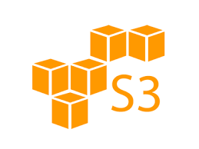
Let’s start with a recent data breach incident
Data breach impacts 100 Million people (July 30, 2019)
How it happened: A hacker gained access through a broken firewall with access control misconfigurations (March 22, 2019).
Notes:
How did it happen?
Interestingly, it turned out the data were stored on aws S3 but were not well protected:
the firewall is misconfigured.
The hacker simply passed through the firewall and accessed the data. This happened in March 22

Slide 4
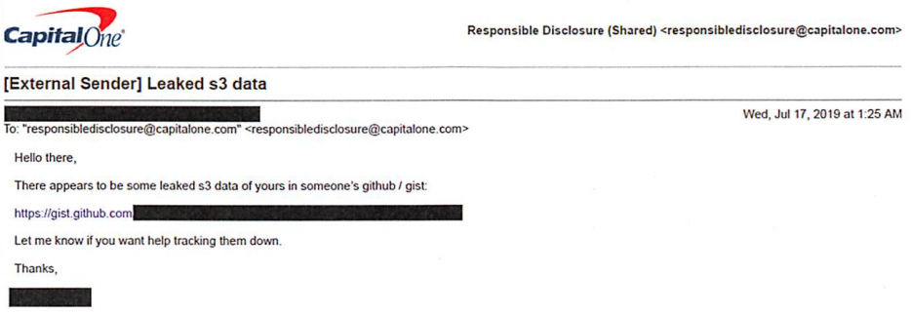
Let’s start with a recent data breach incident
Data breach impacts 100 Million people (July 30, 2019)
How it is discovered: An external sender reported to CapitalOne that there was some data leaked in github (July 18, 2019).
Notes:
What’s more interestingly is after 4 months, an external sender send an email to CapitalOne,
saying their data seemed be leaked in someone’s github, which is the hacker’s github account.

Slide 5
Let’s start with a recent data breach incident
Data breach impacts 100 Million people (July 30, 2019)
How it is discovered
KEEP
CALM
ONLY
4 MONTHS
TO GO
Notes:
So CapitalOne had no idea with the data breach at all for nearly 4 months,
then the hacker disclosed the data by herself,
and finally CapitalOne got to know it at the same time as many other external people, which turned out a big news.

Slide 6
This is not the only data breach by access control misconfigurations
Sep. 16, 2019
Jan. 24, 2019
Apr. 12, 2018
Jun. 19, 2017
Notes:
Now, you may think this is a just corner case.
Let’s just close our capital one account and we will be all safe.
But sadly it is not.
In recent years, many more such data breaches caused by access control misconfigurations were reported.

Slide 7
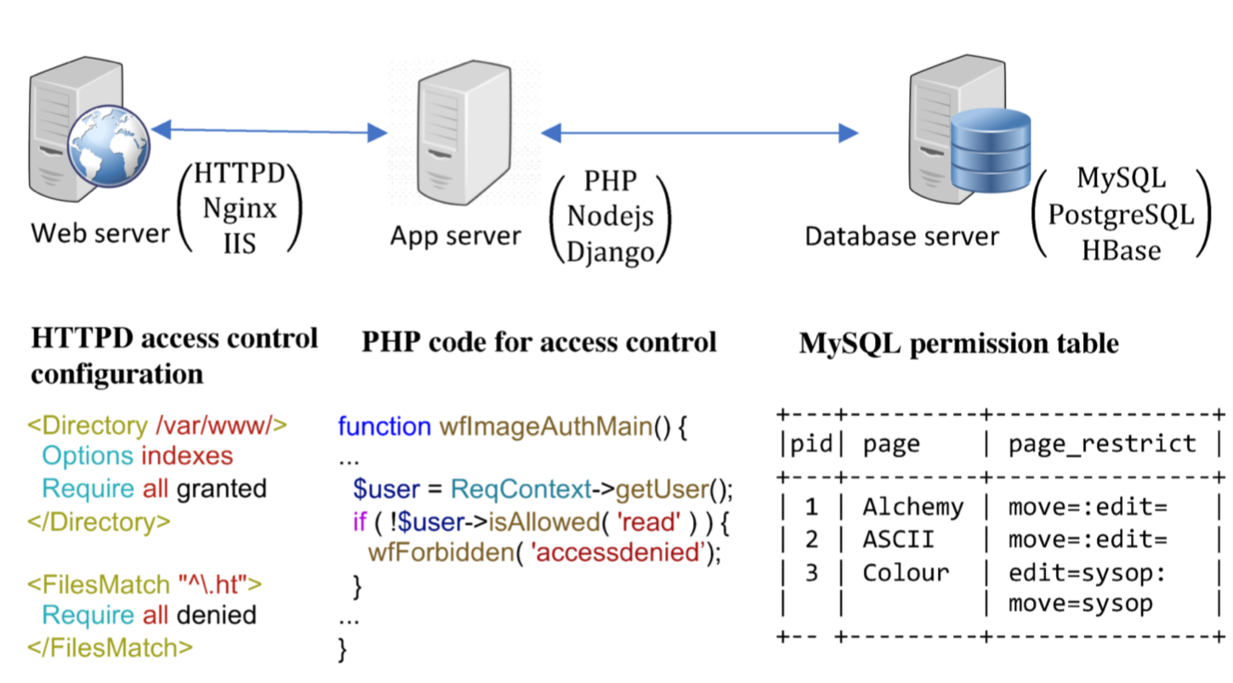
A closer look at Access control configuration
Access control configuration is complicated
Notes:
To understand the problem, let’s take a closer look at access control configuration.
Access control configuration is complicated.
Most of time, it’s not a job of any single piece of software.
Take a typical web system as an example. It has web server, app server and database.

Slide 8
A closer look at Access control configuration
Access control configuration is complicated
Notes:
Each component has its own access control configurations in various format and semantics.
For example, Apache web server uses its own format of access control configuration.
App servers may encode access control in PHP code, javascript, or python.
And MySQL uses a db table to store permissions.
To make the systems work appropriately, a system administrator needs to configure each component correctly.

Slide 9
A closer look at Access control configuration
Access control misconfiguration is hard to discover
system
No obvious symptom
Notes:
However, humans make mistakes.
The worse thing is access control misconfiguration is hard to discover.
First, the misconfigured system may have no obvious symptom: it just allows excessive accesses.

Slide 10
A closer look at Access control configuration
Access control misconfiguration is hard to discover
system
end user
access
No obvious symptom
No incentive to report a breach
Notes:
Second, the end user (presumably good users) who gained excessive access may have no incentive to report the breach,
since the breach will not prevent them working on their own stuff.

Slide 11
A closer look at Access control configuration
Access control misconfiguration is hard to discover
sysadmin
system
end user
manage
access
Do not routinely validate system access logs
No obvious symptom
No incentive to report a breach
Notes:
Third, many sysadmins do not routinely validate system access logs
so they won’t find out the misconfigurations by themselves.

Slide 12
Ways to solve the problem
Detecting access control misconfigurations
[Bauer 2008], [Das 2010], [Fisler 2005]
Can only detect certain types of misconfigurations
Fundamentally: hard to know sysadmins’ intentions
Check configuration and report errors
Notes:
To solve this problem, there may be multiple approaches.
Previous work has been focusing on building tools to detect access control misconfigurations automatically.
These tools can work for certain types of misconfigurations but can hardly detect all type of misconfigurations.
The fundamental reason is automatic tool cannot know sysadmins’ intention, namely, allowing whom to access what data.

Slide 13
Ways to solve the problem
Detecting access control misconfigurations
[Bauer 2008], [Das 2010], [Fisler 2005]
Can only detect certain types of errors
Fundamentally: hard to know sysadmins’ intentions
Validating Access behavior
Lack of tooling support
Totally manual validation is not feasible
Check configuration and report errors
Help admins validate system access behavior
Notes:
Therefore, an alternative approach is to get sysadmins involved by asking them to validate access behavior.
The main problem with this approach is that there are very few tools that have been built for it
and totally manually validation is not feasible.
Our work targeting on making this approach feasible

Slide 14
Validating access behavior is challenging
Asking sysadmins to validate every access is not feasible
Dataset | Time span | # of Access | Average access
Wikipedia | 2 weeks | 369 M | 26 M/day
Center | 11 months | 5.9 M | 18 K/day
Course | 11 months | 3.8 M | 12 K/day
Whova | 3 hours | 100 K | 0.8 M /day
Group | 1 month | 32 K | 1.1K/day
Industry system
Least average access
Notes:
Validating access behavior is not easy.
We cannot simply ask sysadmins to validate every access.
Following is the access logs we collected from both industry and academic systems.
For the smallest system, there are at least over one thousand accesses per day.

Slide 15
Validating access behavior is challenging
Our Solution
Only ask sysadmins to validate when there is an access control behavior (policy) change
e.g. accesses to “/project/detail.doc” are previously denied but now allowed
Notes:
Our solution to this is to only ask sysadmins to validate it when there is an access control behavior or policy change.
For example, accesses to a certain paths may be previously denied but now allowed.
When such a change happens, sysadmins need to pay attention and to double-check if this is what they want.

Slide 16
How can we obtain policy changes?
From access control configurations
Various formats and heterogeneous system architecture
Notes:
Seems clear? Let’s start working on it.
The first question is how we can obtain policy changes.
Let’s take a look at what choices we have.
First, of course the most direct way is from access control configurations.
However, as we discussed before, there are various formats and heterogeneous system architecture.
It’s not very scalable to build tools for every system components, let along each component design may evolve along with time.

Slide 17
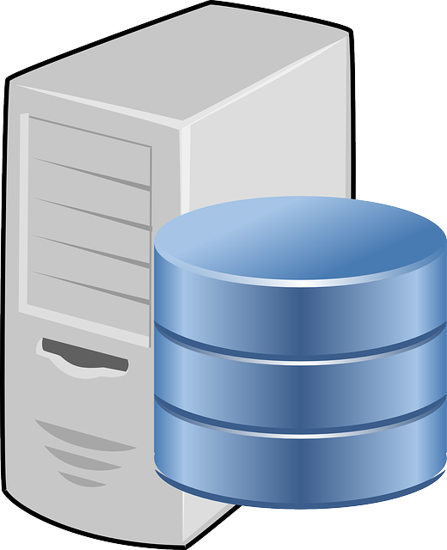
How can we obtain policy changes?
From access control configurations
From access logs
Web server
Httpd access logs
2019-3-12 11:09:21 sysop (user) /index.php?title=Colour&acition=edit 200 (ALLOW)
2019-3-12 11:10:42 anonymous (user) /index.php?title=Colour&acition=edit 403 (DENY)
Various formats and heterogeneous system architecture
End-to-end access behavior
Simple and clear semantics
Notes:
The second approach is from access logs.
If we look at access logs, we can find there usually is an edge component that will records the end to end access behavior,
such as a web server.
In addition, access logs usually have simple and clear semantics, just recording which user or which ip accessed which resource at which time and if it is allowed or denied.
Therefore, we choose to infer policy and policy changes from access logs.

Slide 18
Challenges for Inferring policies from logs
Notes:
There are several challenges for inferring policies from logs.

Slide 19
Challenges for Inferring policies from logs
Why do we need to infer policies?
Can we just compare old and new logs to find changes?
2019-3-12 11:09:21 Alice exam/1.htm deny
…
2019-3-12 11:10:42 Alice exam/1.htm allow
Change
Notes:
But before we delve into that, you may ask do we really need to infer policies
Can we just compare old and new logs to find changes?
Here are example logs show that Alice cannot get access to an exam page before but later can access it.
If we compare these two accesses, wouldn’t we be able to find the change?

Slide 20
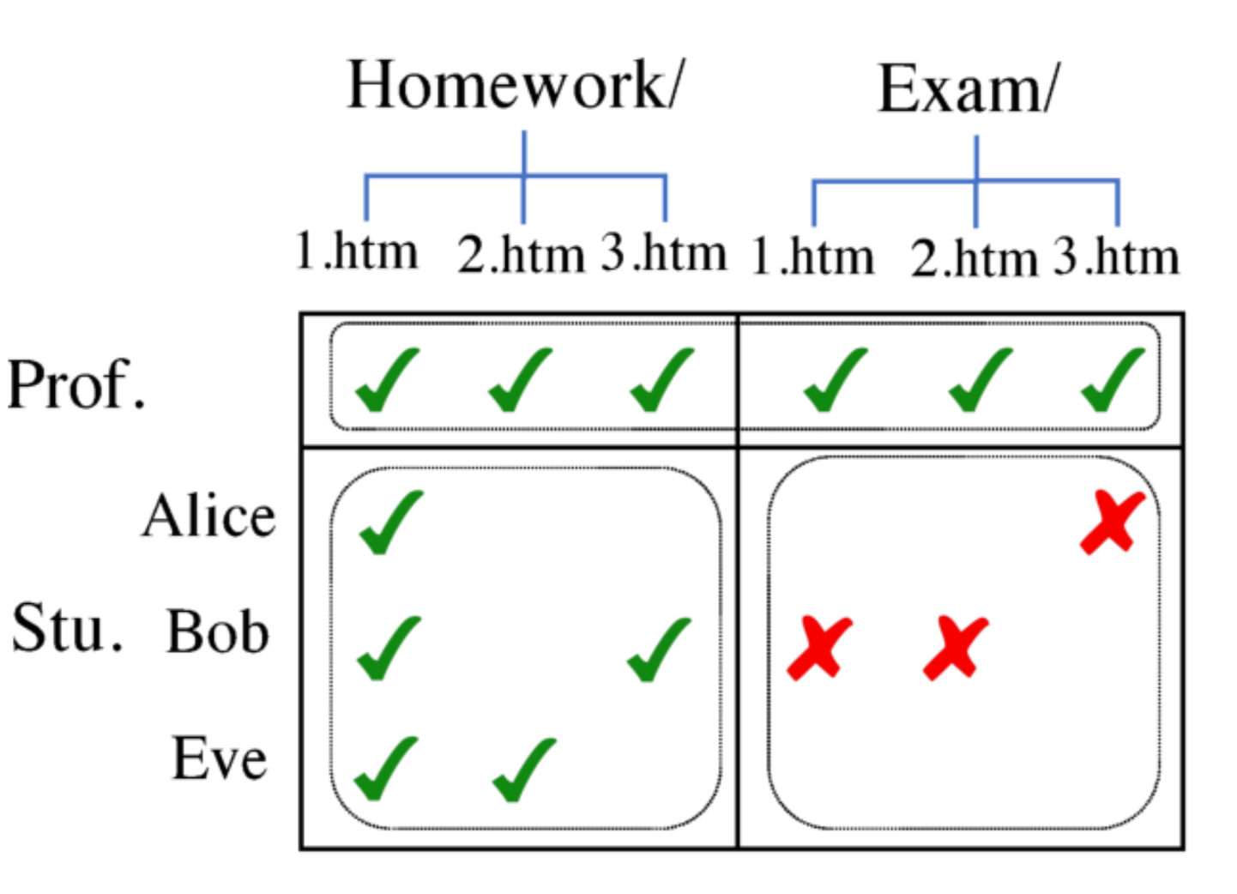
Challenges for Inferring policies from logs
Why do we need to infer policies?
Can we just compare old and new logs to find changes?
Access logs are sparse
Cannot find a direct comparison target
Policy
Prof. */* allow
Stu. Homework/* allow
Stu. Exam/* deny
Notes:
Not exactly.
The reason is access logs are sparse.
Here is a figure that visualizes access logs: the columns are for directories and files, the rows are for roles and users.
In real systems, most people only access a few files they care.
Therefore, for a new access we may not be able to find an old access that are directly comparable.
[click]
By inferring policy, we can aggregate single access into rectangles and each rectangle represents a policy.
In this way, the comparison can be based on rectangles or policies instead of each individual access.

Slide 21
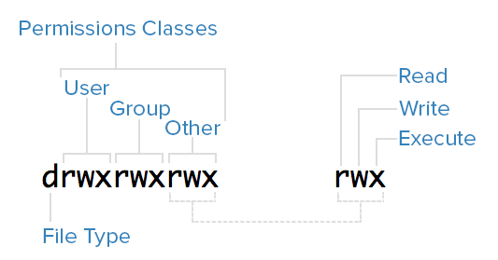
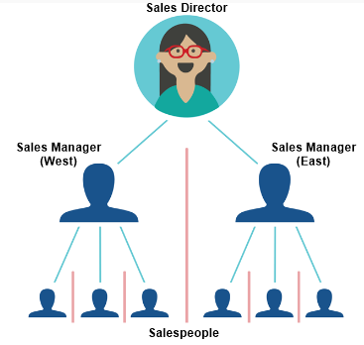
Challenges for Inferring policies from logs
Challenge 1: how to uniformly represent policies of various access control models
IP
url
user
Web request
Unix file permissions
Role-based access control
Attribute-based access control
Notes:
Let’s go back to the challenges of inferring policies
The first challenge is how to uniformly represent policies of various access control models.
Here are three examples of different access control models:
they are unix file permission in file systems, role-based access control in a company system,
and attribute-based access control in a httpd server.

Slide 22
Challenges for Inferring policies from logs
Solution: use a decision tree model to represent them
Decision tree-represented policy
Visualized access logs
Decision tree-represented policy
Visualized access logs
IF $role == “Prof.”
True
False
Allow
IF $dir== “Exam”
True
False
Deny
Allow
Notes:
To represent them, we adopt a decision tree model.
Now let me use an example to explain it.
The left side is the visualized access logs as we discussed before, the right side is the decision tree-represented policy.

Slide 23
Challenges for Inferring policies from logs
Solution: use a decision tree model to represent them
Decision tree-represented policy
Visualized access logs
Decision tree-represented policy
Visualized access logs
Exam/
IF $role == “Prof.”
Prof.
True
False
Prof.
Allow
IF $dir== “ Exam”
Exam
True
False
Deny
Allow
Notes:
The decision tree encodes roles, dirs and maybe users and files in its intermediate nodes and makes decisions based on them.

Slide 24
Challenges for Inferring policies from logs
Solution: use a decision tree model to represent them
Decision tree-represented policy
Visualized access logs
Decision tree-represented policy
Visualized access logs
IF $role == “Prof.”
True
False
Allow
IF $dir== “Exam”
Allow
True
False
Deny
Allow
Deny
Allow
Notes:
Each rectangle of results are encoded in a leaf node.

Slide 25
Challenges for Inferring policies from logs
Solution: use a decision tree model to represent them
Flexibility to encode Step-by-step decision
Inherent hierarchical structure
Visualized access logs
Decision tree-represented policy
IF $role == “Prof.”
True
False
Allow
IF $dir== “Exam”
True
False
Deny
Allow
Notes:
This has two benefits.
First, it is flexible to encode step-by-step decisions
Second, it can inherently encode hierarchical structure, like parent directory and files.

Slide 26
Challenges for Inferring policies from logs
Challenge 2: how to represent and infer policy changes
Access logs
Traditional decision tree-represented policy
T1, PUT, /proj/1.html deny
T2, GET, /proj/2.html deny
T3, GET, /proj/3.html deny
T4, GET, /proj/4.html allow
T5, GET, /proj/5.html allow
T6, PUT, /proj/6.html deny
IF $prefix1 == “/proj”
True
False
IF $method == “GET”
···
True
False
50% deny
50% allow
···
Notes:
The second challenge is how to represent and infer policy changes.
Here are examples of access logs
As shown in the green part, there is a policy change of ”GET Proj files” from deny to allow.
[click]
Using a traditional decision tree, the blue leaf node will encode 50% deny and 50% allow.
This has no information of policy changes at all.

Slide 27
Challenges for Inferring policies from logs
Solution: a new time-changing decision tree to encode policy changes
Traditional decision tree-represented policy
Time-changing decision tree-represented policy
IF $prefix1 == “/proj”
IF $prefix1 == “/proj”
True
False
True
False
IF $method == “GET”
···
IF $method == “GET”
···
True
False
True
False
50% deny
50% allow
···
Status
···
deny
allow
T2
T3
T4
T5
Timestamp
Notes:
To address this, we propose a new time-changing decision tree to encode policy changes in the leaves.
As show in the green node, a time-series of access results will be encoded.
The change is encoded in the inflection point and can be easily obtained.

Slide 28
New Challenge: how to infer policies with changes
Traditional decision tree learning algorithms cannot recognize policies with changes
Notes:
But how to infer the polices with changes, namely build the tree.
Traditionally, decision trees are built with learning algorithms.
These learning algorithms use some statistic metrics to decide appropriate policies.
The most common metrics are gini impurity and entropy

Slide 29
New Challenge: how to infer policies with changes
Traditional decision tree learning algorithms cannot recognize policies with changes
Set
Gini impurity / entropy: measure the purity of a set
IF $prefix1 == “/proj”
IF $prefix1 == “/proj”
True
True
IF $method == “GET”
IF $method == “GET”
True
True
50% deny
50% allow
100% deny (allow)
Notes:
Their main idea are both measuring the purity of a set.
For example, on the left side, the result set is half deny and half allow, which is impure.
So both metrics are big, indicating this is not a policy.
On the right side, the result set is all deny or all allow, which is pure.
So both metrics are small, indicating this is a policy.

Slide 30
New Challenge: how to infer policies with changes
Traditional decision tree learning algorithms cannot recognize policies with changes
Set
Gini impurity / entropy: measure the purity of a set
IF $prefix1 == “/proj”
True
IF $method == “GET”
True
50% deny
50% allow
NOT policy
Policy with changes
Notes:
But the left cause could be also be a policy with changes.

Slide 31
New Challenge: how to infer policies with changes
Traditional decision tree learning algorithms cannot recognize policies with changes
Recognize policy with changes: measure changes in the
Time series
IF $prefix1 == “/proj”
IF $prefix1 == “/proj”
IF $prefix1 == “/proj”
True
True
True
IF $method == “GET”
IF $method == “GET”
IF $method == “GET”
True
True
True
50% deny
50% allow
Status
Status
deny
deny
allow
allow
NOT policy
T2
T3
T4
T5
T2
T3
T4
T5
Timestamp
Timestamp
Policy with changes
Changes: 3
NOT Policy
Changes: 1
Policy with changes
Notes:
To address this, we propose a new algorithm to order results as a time series and use the number of changes or inflection points as the metric.
With the new metric, we can differentiate the NOT policy case with the policy with changes case.
The middle one is the NOT policy case, in which there are many changes because most accesses are independent and random.
But in the right case of policy with changes, there are fewer changes because the accesses are controlled by one policy.

Slide 32
New Challenge: how to infer policies with changes
Traditional decision tree learning algorithms cannot recognize policies with changes
Recognize policy with changes: measure changes in the
Time series
IF $prefix1 == “/proj”
IF $prefix1 == “/proj”
IF $prefix1 == “/proj”
True
True
True
IF $method == “GET”
IF $method == “GET”
IF $method == “GET”
Hah, interesting?
More details in our paper!
True
True
True
50% deny
50% allow
Status
Status
deny
deny
allow
allow
NOT policy
T2
T3
T4
T5
T2
T3
T4
T5
Policy with changes
Timestamp
Timestamp
Changes: 3
NOT Policy
Changes: 1
Policy with changes
Notes:
Due to time limit, I won’t dive into the details.
If you are interested, welcome to read more in our paper!

Slide 33
Overview of our solution: P-DIFF
Access logs
Time-changing decision tree-represented policy
Two Use cases
T1, PUT, /proj/1.html deny
T2, GET, /proj/2.html deny
T3, GET, /proj/3.html deny
T4, GET, /proj/4.html allow
T5, GET, /proj/5.html allow
T6, PUT, /proj/6.html deny
Sysadmin
IF $prefix1 == “/proj”
Change validation
True
False
IF $method == “GET”
···
Policy Inference
True
False
Status
···
Change forensics
deny
allow
T2
T3
T4
T5
Timestamp
Notes:
Now, it’s time to give an overview of our proposed tool, P-DIFF.
P-Diff takes access logs as input
[click]
and infers a time-changing decision tree from them.
[click]
With the tree-represented policies, P-DIFF enabled two use case with the involvement of sysadmins.

Slide 34
Use case 1
Change validation: detect policy changes and warn sysadmins to validate
IF $prefix1 == “/proj”
True
False
IF $method == “PUT”
···
True
False
Status
···
deny
allow
T1
T2
T3
T4
Timestamp
Notes:
The first use case is change validation.
For this case, PDiff first infers a tcdt from access logs as currently observed policies

Slide 35
Use case 1
Change validation: detect policy changes and warn sysadmins to validate
IF $prefix1 == “/proj”
New-coming access:
True
False
T5, PUT, /proj/1.htm allow
IF $method == “PUT”
···
True
False
Status
···
deny
allow
T1
T2
T3
T4
Timestamp
Notes:
If a new access comes, p-diff will go through the tcdt
and speculate if it should be denied or allowed based on previous policy

Slide 36
Use case 1
Change validation: detect policy changes and warn sysadmins to validate
/proj
IF $prefix1 == “/proj”
New-coming access:
True
False
/proj
IF $method == “PUT”
···
T5, PUT, /proj/1.htm allow
True
False
Status
···
deny
allow
T1
T2
T3
T4
Timestamp
Notes:
As in this example, it will look up the tree with the related features of the new access, first ”/proj” as dir prefix

Slide 37
Use case 1
Change validation: detect policy changes and warn sysadmins to validate
IF $prefix1 == “/proj”
New-coming access:
True
False
IF $method == “PUT”
···
PUT
PUT
T5, PUT, /proj/1.htm allow
True
False
Status
···
deny
allow
T1
T2
T3
T4
Timestamp
Notes:
Then PUT as the method

Slide 38
Use case 1
Change validation: detect policy changes and warn sysadmins to validate
IF $prefix1 == “/proj”
New-coming access:
True
False
T5, PUT, /proj/1.htm allow
IF $method == “PUT”
···
T5
allow
True
False
Status
···
deny
allow
T1
T2
T3
T4
T5
Timestamp
Notes:
Finally, it goes to a leaf.
P-diff will compare the new result at T5, which is deny, with the most recent result at T4, which is allow.

Slide 39
Use case 1
Change validation: detect policy changes and warn sysadmins to validate
IF $prefix1 == “/proj”
New-coming access:
True
False
Warning: a new policy change
T5, PUT, /proj/1.htm allow
IF $method == “PUT”
···
T5
allow
T4-T5, PUT, /proj deny allow
True
False
Status
···
deny
allow
T1
T2
T3
T4
T5
Timestamp
Notes:
Then, P-Diff reports a policy change between T4 and T5 and notifies sysadmins to validate it.

Slide 40
Use case 2
Change forensics: find historical policy change related to a risky access
IF $prefix1 == “/proj”
True
False
IF $method == “GET”
···
True
False
Status
···
deny
allow
T1
T2
T3
T5
Timestamp
Notes:
The second case is when sysadmins found a risky access,
they can use P-Diff to check the related policy change history.

Slide 41
Use case 2
Change forensics: find historical policy change related to a risky access
IF $prefix1 == “/proj”
Risky access:
True
False
T4, GET, /proj/1.htm allow
IF $method == “GET”
···
True
False
Status
···
deny
allow
T1
T2
T3
T5
Timestamp
Notes:
In this example, sysadmins found a risky access at T4, which allowed GET a proj page

Slide 42
Use case 2
Change forensics: find historical policy change related to a risky access
IF $prefix1 == “ /proj”
/proj
Risky access:
True
False
/proj
IF $method == “GET”
···
T4, GET, /proj/1.htm allow
True
False
Status
···
deny
allow
T1
T2
T3
T5
Timestamp
Notes:
Similarly, P-diff looks up the tree, first /proj

Slide 43
Use case 2
Change forensics: find historical policy change related to a risky access
IF $prefix1 == “ /proj”
Risky access:
True
False
IF $method == “ GET”
···
T4, GET, /proj/1.htm allow
GET
GET
True
False
Status
···
deny
allow
T1
T2
T3
T5
Timestamp
Notes:
Then get

Slide 44
Use case 2
Change forensics: find historical policy change related to a risky access
IF $prefix1 == “ /proj”
Risky access:
True
False
T4, GET, /proj/1.htm deny
IF $method == “ GET”
···
T4
allow
True
False
Status
···
deny
allow
T1
T2
T3
T4
T5
Timestamp
Notes:
It finally finds the leaf node and locates T4 in the time series

Slide 45
Use case 2
Change forensics: find historical policy change related to a risky access
IF $prefix1 == “ /proj”
Risky access:
True
False
T4, GET, /proj/1.htm deny
IF $method == “ GET”
···
T4
allow
True
False
Status
···
deny
allow
T1
T2
T3
T4
T5
Timestamp
Notes:
It then looks back the time series and finds the policy change between T2 and T3 that enabled the access

Slide 46
Use case 2
Change forensics: find historical policy change related to a risky access
IF $prefix1 == “ /proj”
Risky access:
True
False
A related historical change
T4, GET, /proj/1.htm deny
IF $method == “ GET”
···
T4
allow
T2-T3, GET, /proj deny allow
True
False
Status
···
deny
allow
T1
T2
T3
T4
T5
Timestamp
Notes:
Therefore, P-Diff reports the historical change for sysadmins to diagnose.

Slide 47
Evaluation setup
Controlled experiments
Real-world access logs
Random injected policy changes
Access log dataset
Dataset | Configuration | Time span | # of Access
Wikipedia | Application logic | 2 weeks | 369 M
Center | Web server configuration | 11 months | 5.9 M
Course | File permission | 11 months | 3.8 M
Whova | Firewall | 3 hours | 100 K
Group | File permission | 1 month | 32 K
Industry system
Notes:
We evaluate P-Diff with controlled experiments.
We use real-world access logs to feed into p-diff,
and because some of them do not have ground truth for changes, we also randomly inject policy changes to those logs.
[click]
We used five datasets, including two from industry systems and three from academic systems.
They covered different types of access control configurations and with different scale of accesses.

Slide 48
Evaluation result
Accuracy of policy change detection (use case 1)
Dataset | Total changes | Detected changes | Precision (False positives) | Recall (False negatives)
Wikipedia | 25 | 25 (100%) | 1.0 (0) | 1.0 (0)
Center | 18 | 16 (89%) | 0.76 (5) | 0.89 (2)
Course | 18 | 17 (94%) | 0.85 (3) | 0.94 (1)
Whova | 21 | 18 (86%) | 0.81 (4) | 0.86 (3)
Group | 17 | 17 (100%) | 1.0 (0) | 1.0 (0)
Total | 99 | 93 (94%) | 0.89 (12) | 0.94 (6)
best
Worst
Notes:
Here is the evaluation results. For policy change detection, p-diff can detect 93 out of total 99 changes with a precision of 0.89.
For different datasets, p-diff’s performance varies.
[click]
The best case is for Wikipedia and group, in which p-diff achieves both 100% precision and 100% recall.
[click]
The worst case is for center and whova.
The reason is some files or ips rarely exist in logs.
So p-diff cannot inferred correct policies for them.

Slide 49
Evaluation result
Accuracy of forensic diagnosis (use case 2)
Dataset | Access diagnosed | Root-cause changes Pinpointed
Wikipedia | 63 | 61 (97%)
Center | 60 | 53 (88%)
Course | 60 | 59 (98%)
Whova | 60 | 51 (85%)
Group | 60 | 59 (98%)
Total | 303 | 283 (93%)
best
Worst
Notes:
For forensic diagnosis, p-diff can successfully pinpoint 283 out of 303 diagnosed accesses.
[click]
The best case is 98% and the worst case if 85%.
The reason for the worst case is also p-diff failed to generate policies for rarely accessed objects.

Slide 50
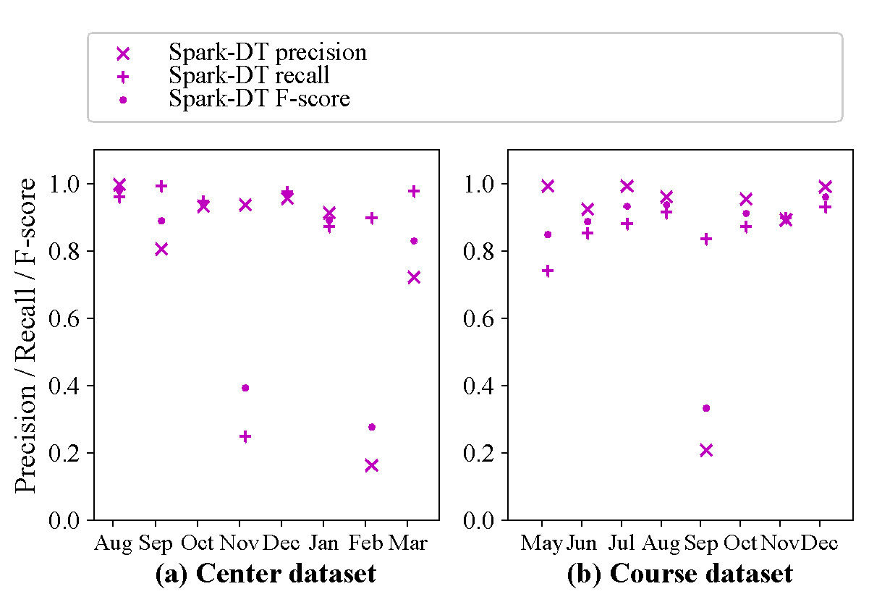
Accuracy analysis: access result prediction
Using Spark-DT
Spark-DT’s average precision: 0.83, recall: 0.86, and F-score: 0.80.
Notes:
We also analyzed p-diff’s accuracy as a classifier for access result.
We use spark-decision tree as the base line.
It got a precision of 0.83, recall of 0.86 and f-score of 0.8.

Slide 51
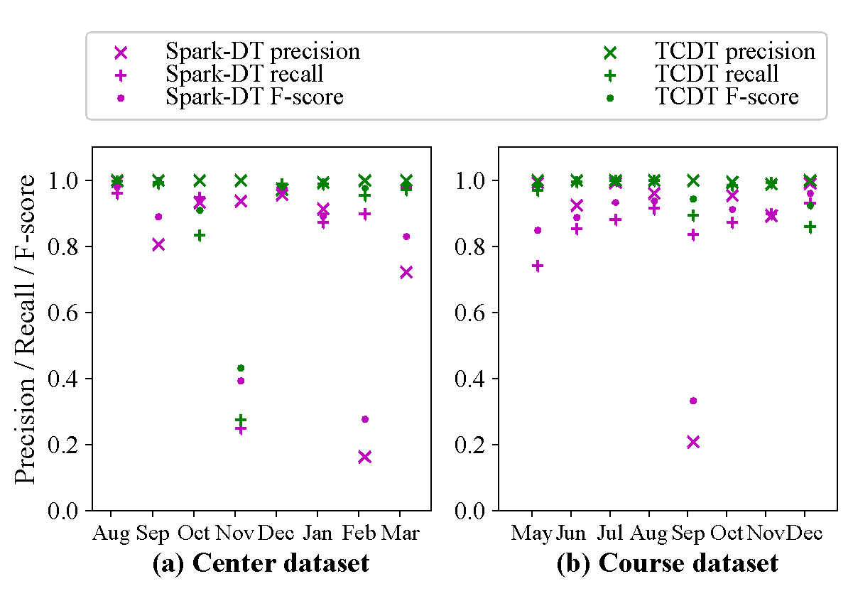
Accuracy analysis: access result prediction
TCDT vs Spark-DT
P-DIFF-TCDT’s precision: 0.997 (+0.167), recall: 0.92 (+0.06), and F-score: 0.94 (+0.14).
Notes:
In comparison, P-DIFF-TCDT improves precision by 0.16, recall by 0.06, and F-score by 0.14.
We can see from the figure that the green points, which represent TCDT are above purple points, which represent spark-DT for most of time.

Slide 52
Conclusion
We present a tool, P-DIFF, to help sysadmins validate and diagnose accesses
Infers access control policies from access logs
Validation: Detects policy changes and ask sysadmins to validate them
Forensics: Helps sysadmins find out which historical change enabled a risky access
Notes:
In conclusion, we present a tool, P-Diff, which can help sysadmins to validate and diagnose accesses.
It infers access control policies from access logs and enables two use cases
first for validation, it detects new policy changes and ask sysadmins to validate them
second for forensics, it helps sysadmins find out which historical change enabled a risky access

Slide 53
Conclusion and Takeaways
We present a tool, P-DIFF, to help sysadmins validate and diagnose accesses
Infers access control policies from access logs
Validation: Detects policy changes and ask sysadmins to validate them
Forensics: Helps sysadmins find out which change enabled a risk access
Takeaways
Decision tree is effective on representing various access control models
Using machine learning to infer system policies needs to handle policy changes
Consider our Time-Changing Decision Tree (TCDT)!
Notes:
I would also like to share two takeaways with you
First, from our experience, decision tree is effective on representing various access control models
second, if you are using machine learning algorithm to infer system policies, you may want to be aware of the policy change issues.
To address the issue, our TCDT could be a potential choice.
Thank you for listening and with this I’m happy to take questions

Slide 54
Thank you!
Q&A

Slide 55
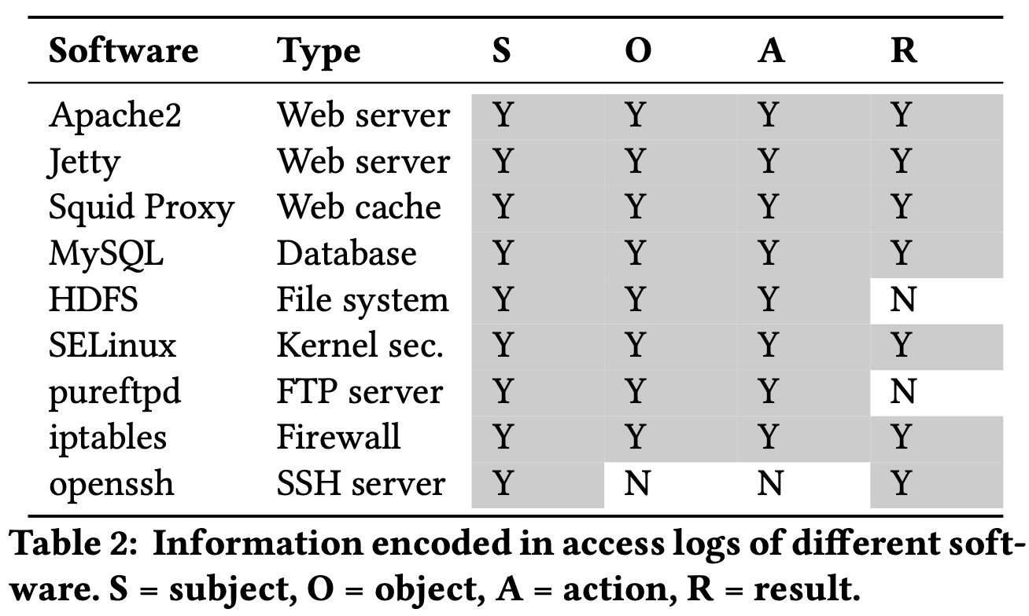
Backup: access logs

Slide 56
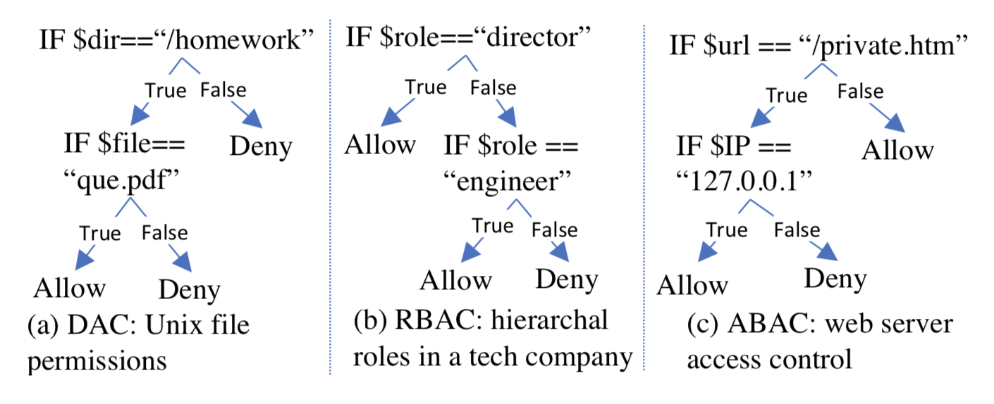
Backup: Different access control models

Slide 57
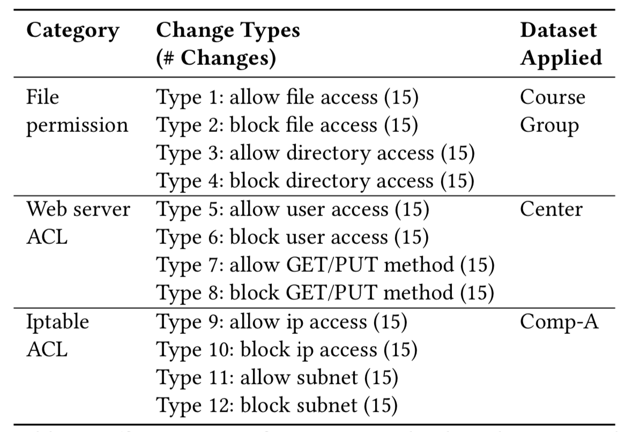
Backup: Inject policy changes
Notes:
As we only have the change ground truth for Wikipedia, we inject policy changes in the other four datasets for evaluation

Slide 58
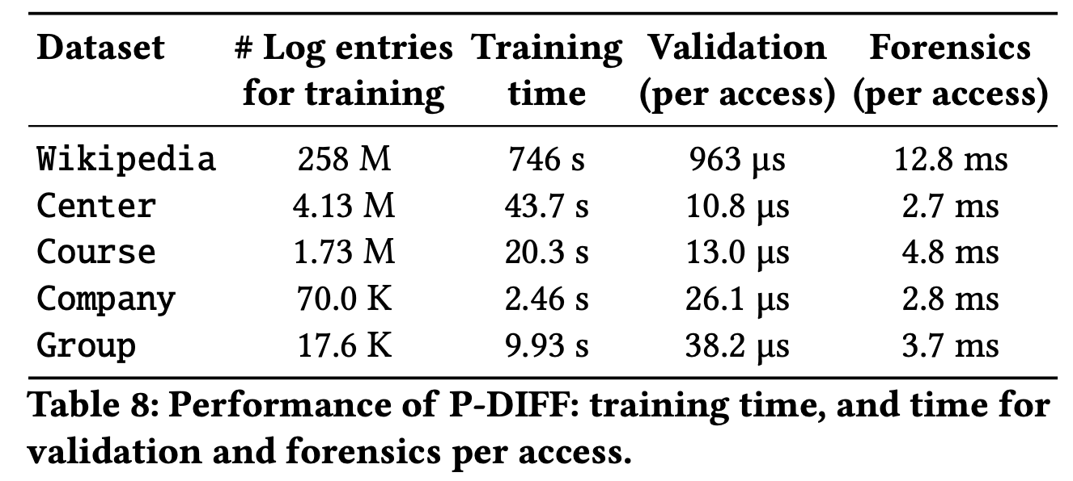
Backup: performance
Notes:
As we only have the change ground truth for Wikipedia, we inject policy changes in the other four datasets for evaluation

Slide 59
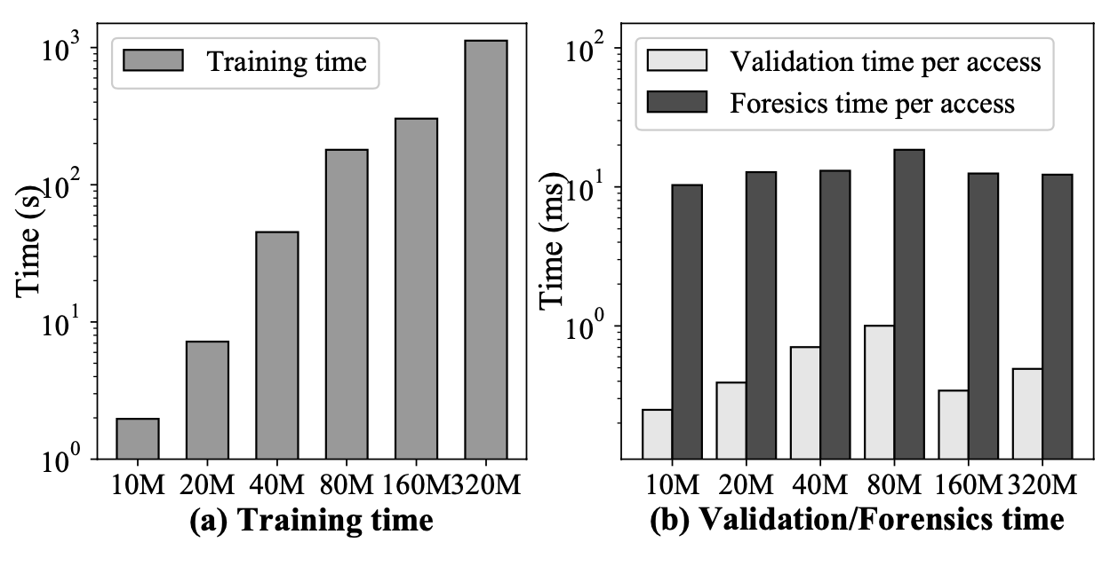
Backup: scalability
Notes:
As we only have the change ground truth for Wikipedia, we inject policy changes in the other four datasets for evaluation

